Slide 1
An 8-pole lap–connected armature driven at 350 rev/min is required to generate 260 V. The useful flux per pole is about 0.05 Wb. If the armature has 120 slots, calculate a suitable number of conductors per slot and the corresponding useful flux per pole.

Slide 2
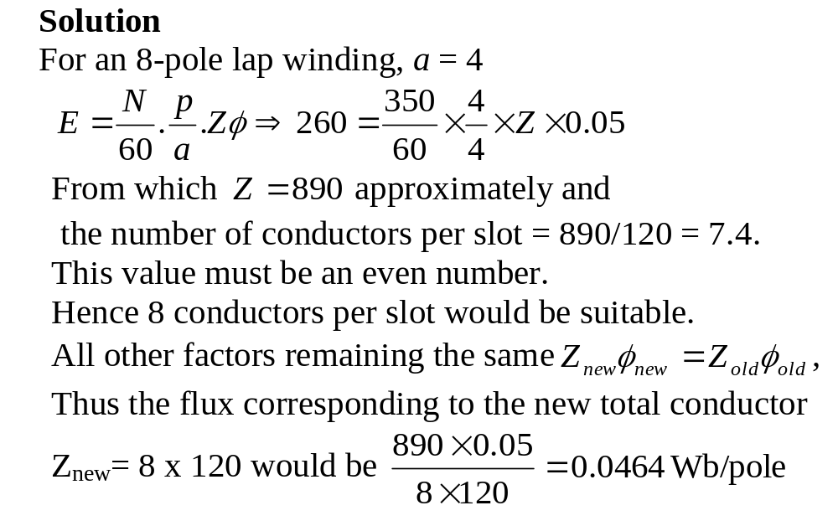

Slide 3
An 8-pole armature is wound with 480 conductors. The magnetic flux and the speed are such that the average e.m.f. generated in each conductor is 2.2 V; each conductor can carry a full-load current of 100A. Calculate the terminal voltage on no load, the output current on full load and the total power generated on full load when the armature is (a) lap-connected and (b) wave-connected.

Slide 4
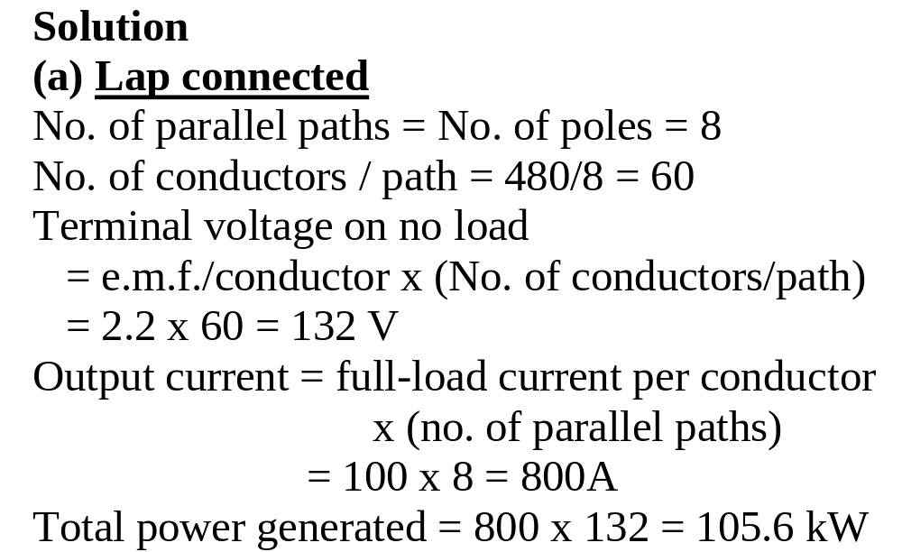

Slide 5
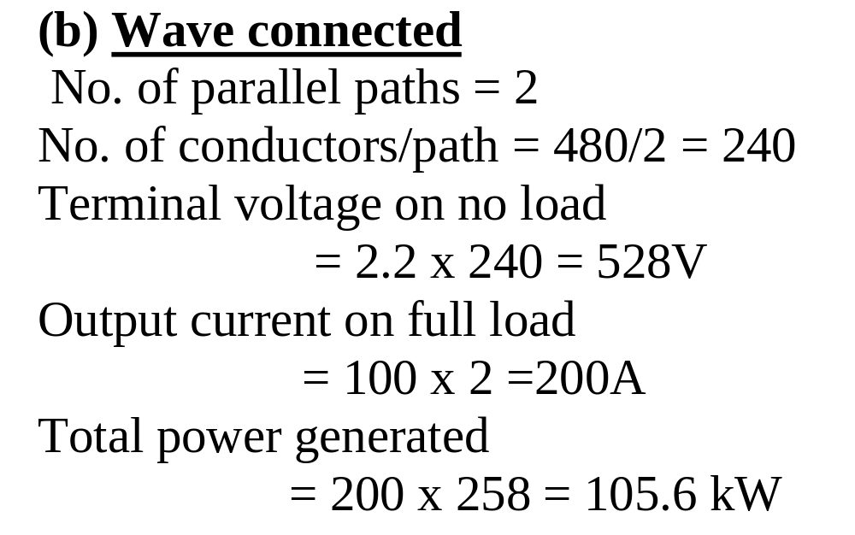

Slide 6
The wave-connected armature of a 4-pole dc generator is required to generate an emf of 520V when driven at 660 rev/min. Calculate the flux per pole required if the armature has 144 slots with 2 coil sides (or 1 coil) per slot, each consisting of 3 turns.

Slide 7
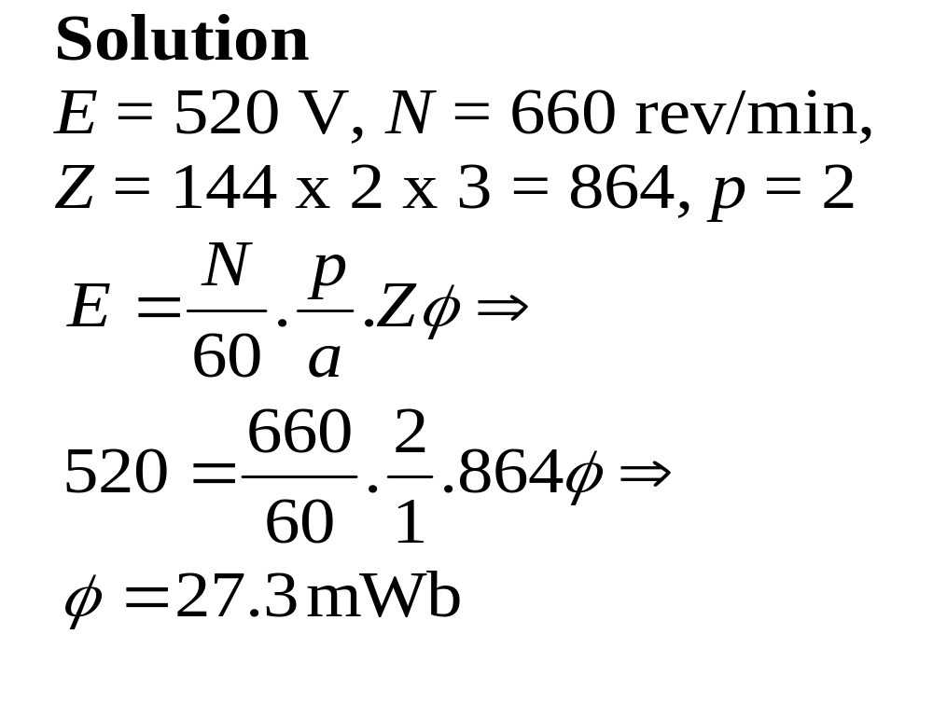

Slide 8
3-phase armature windings
The wdg is composed of conductors in a no. of evenly spaced slots around the gap surface of the stator.
The conductors are arranged in 3 balanced sections.
The conductors in a section are interconnected to form a phase winding.

Slide 9
Definitions
Phase or coil groups
Coils staggered at one-slot interval when connected in series form a phase or coil group.
The voltage of a coil group is given by the phasor sum of the constituent individual coil emfs, which because they are staggered, have emfs displaced in time phase.

Slide 10
Coil voltage:
The voltage of a coil is obtained by the product of the no. of conductors in the coil and the voltage per conductor when it is full-pitch.
If the coil is not full-pitch the product has to be multiplied by coil-span factor

Slide 11
Phase winding:
The phase or coil groups may be connected in series, in parallel or in series-parallel to obtain a phase winding.
The phase or coil groups of a phase winding are spaced uniformly around the stator.

Slide 12
The voltage of a phase winding is the arithmetic sum of the voltages of the phase or coil groups (per parallel i.e. when they are parallel as well)
Phase spread or phase groupings:
The way the conductors or coil-sides are arranged in 3-balanced sections gives what is called 60º or 120º phase spread or phase group.

Slide 13
For the 60º phase spread, the coil-sides over two pole pitches, i.e. 360º are divided into 6 groups, each group spreading over 60º.
The groups are assigned to the three phases A, B and C in the sequence A, C', B, A', C and B'.

Slide 14
For a given phase X, the conductors are interconnected such that the current in the conductors in section X and the current in conductors in section X' flow in opposite directions.

Slide 15
In the case of the 120º phase spread, the coil-sides over two pole pitches are divided into 3 groups, each group spreading over 120º.
  For two-layer winding, the groupings of coil-sides given in Fig. 11 represent the groupings of the top-layer coil-sides only.

Slide 16
Coils have return conductors a pole-pitch or less away to give turns. For this reason, the 120º phase spread is possible with two-layer winding but not possible with single-layer wdg.
With 60º phase spread, both single- and two-layer windings can be used.
In ac wdg, u = 1, hence C = S in the 2-layer wdg and C = S/2 in 1-layer .

Slide 17
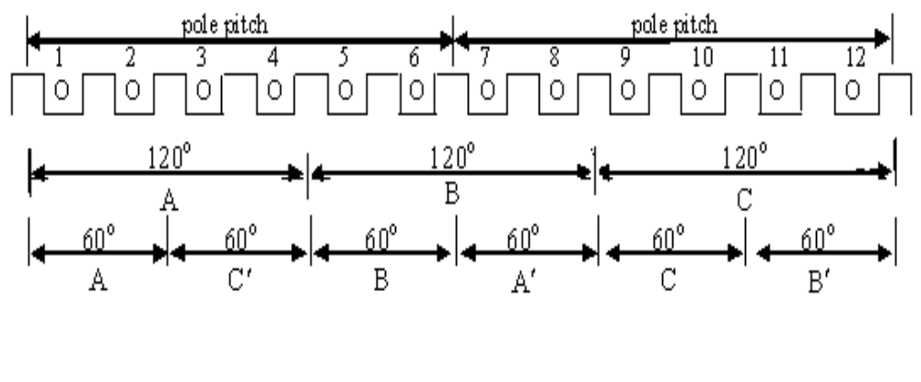
Fig. 11 Phase groupings

Slide 18
No of groupings per pole (G_{pp})
= 3 for 60º groupings,
= 3/2 for 120º phase spread
The total number of groupings (G_{p})
= G_{pp} x No. of poles
=3 x (2p) = 6p for the 60º
=3/2 x (2p) = 3p for the 120º

Slide 19
For two layer winding, total no. of coil groups C_{gp} = G_{p}
= 6p for the 60º
= 3p for the 120º
For single layer winding (60º phase spread only), total no. of coil groups
= halve of that of 2 layer
= 3p for 60º

Slide 20
For two layer winding, total no. of coils per groups
m = C/ C_{gp} = S/ C_{gp}
For 60º m = S/6p = S/(3 x 2p) which can be interpreted as the no. of slots per pole per phase
For 120º, m = 2 x m for 60º

Slide 21
For single layer (60º phase spread only), m is the same as that of 2 layer, i.e.,
m = S/(3 x 2p) or no. of slots per pole per phase
Coil span y_{b} = slot span = S/2p for full pitch coils because u = 1

Slide 22
Consider a two layer winding with S = 24 and total no. of poles 2p = 4.
For 60º groupings or phase spread,
total no of coil groups, C_{gp} = 12
no. of coils per group, m = 2
For 120º groupings or phase spread,
total no of coil groups, C_{gp} = 6
no. of coils per group, m = 4

Slide 23
For single layer, m = 2
Coil span y_{b} = 24/4= 6 if coils are full pitch
The return conductor for conductor no. 1 in a 2 layer winding is conductor no. 1 + 6 = 7'

Slide 24
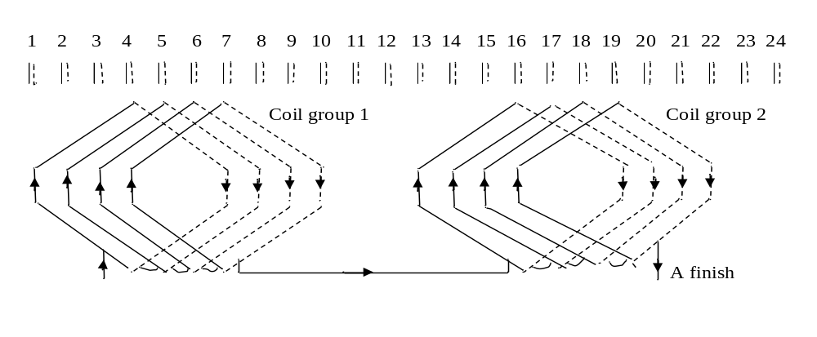
Examples of 3-phase windings
Fig. 12.a 120º groups, 2-layer lap: 2 phase groups are connected in series

Slide 25
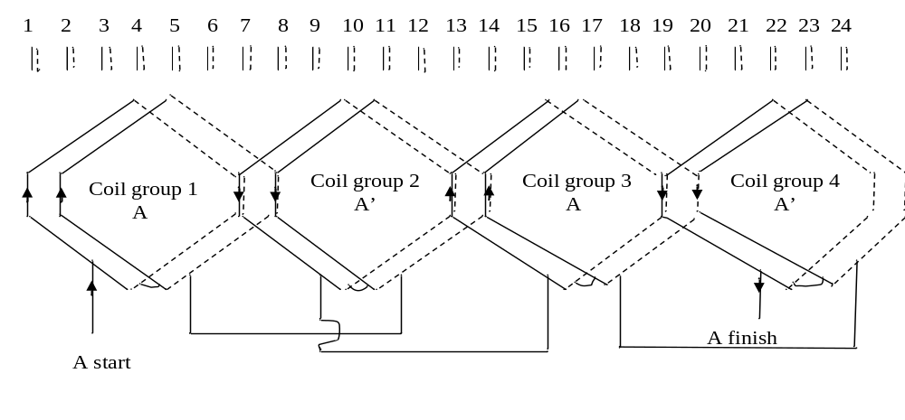
Fig. 12.b 60º groups, 2 layer lap: 4 phase groups are connected in series

Slide 26
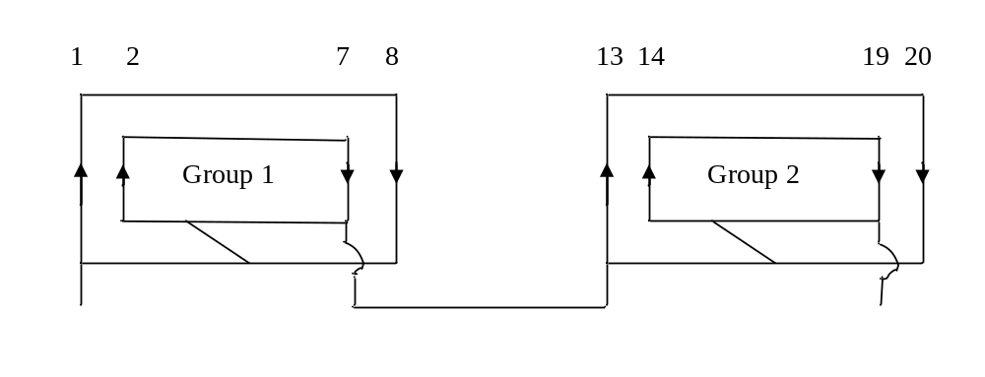
Fig. 12.c 60º groups, 1-layer concentric groups connected in series

Slide 27
The armatures of nearly all synchronous generators and of most induction motors above a few horse powers are wound with 2-layer windings.
The most usual phase spread or phase grouping or coil group is 60º.
The type of coil used in modern machines is lap.

